Slide 2
INTRO TO IEEE

Slide 3
Overview
Why we cite
Basics of
citation
in-text citation
IEEE practice

Slide 4
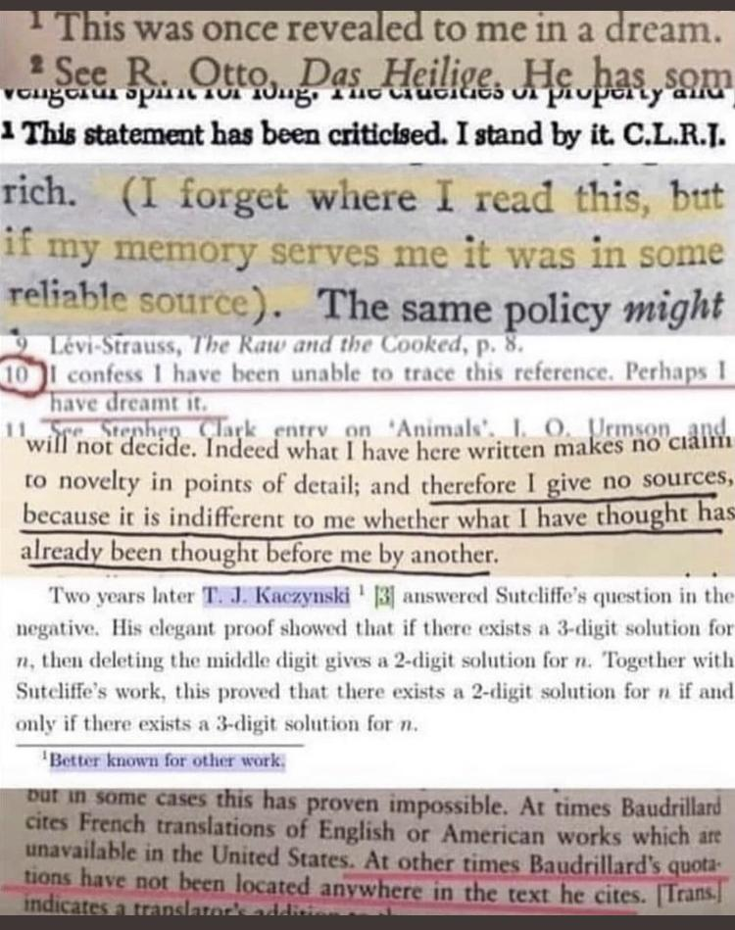
Why we cite
Breadcrumbs
Research replication
Credit where credit’s due

Slide 5
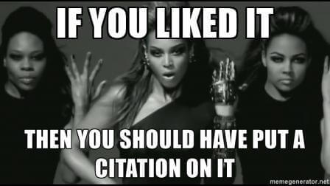
Failure to cite is plagiarism

Slide 6
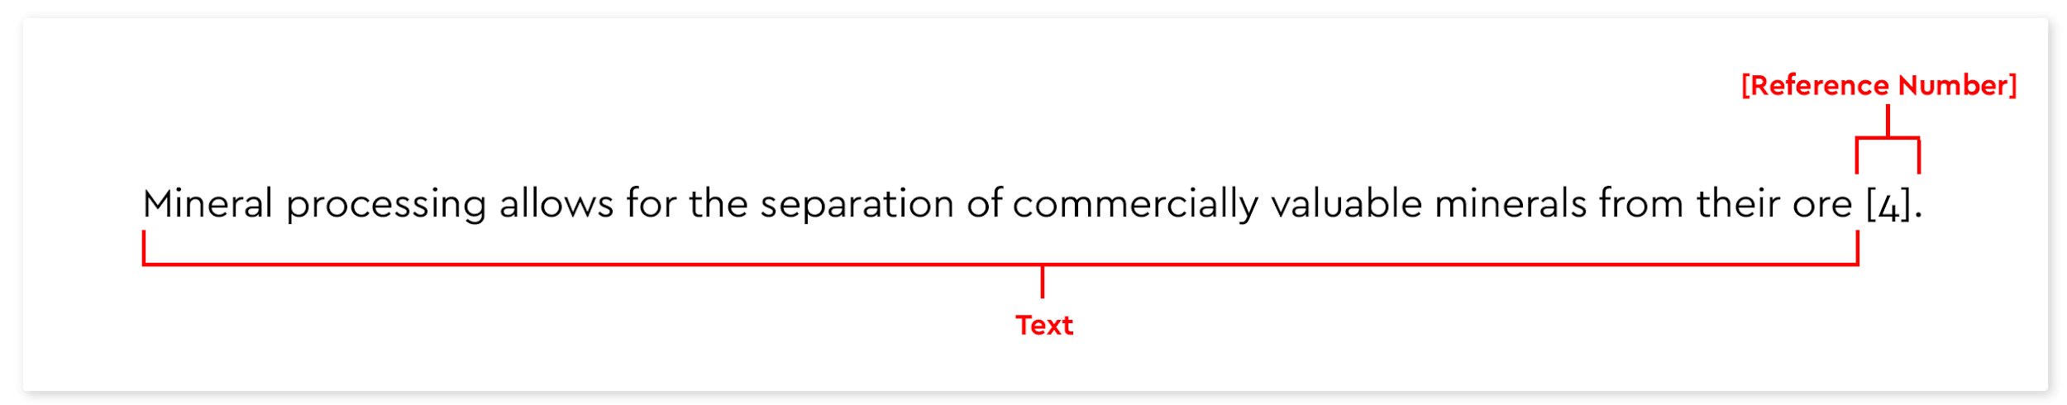
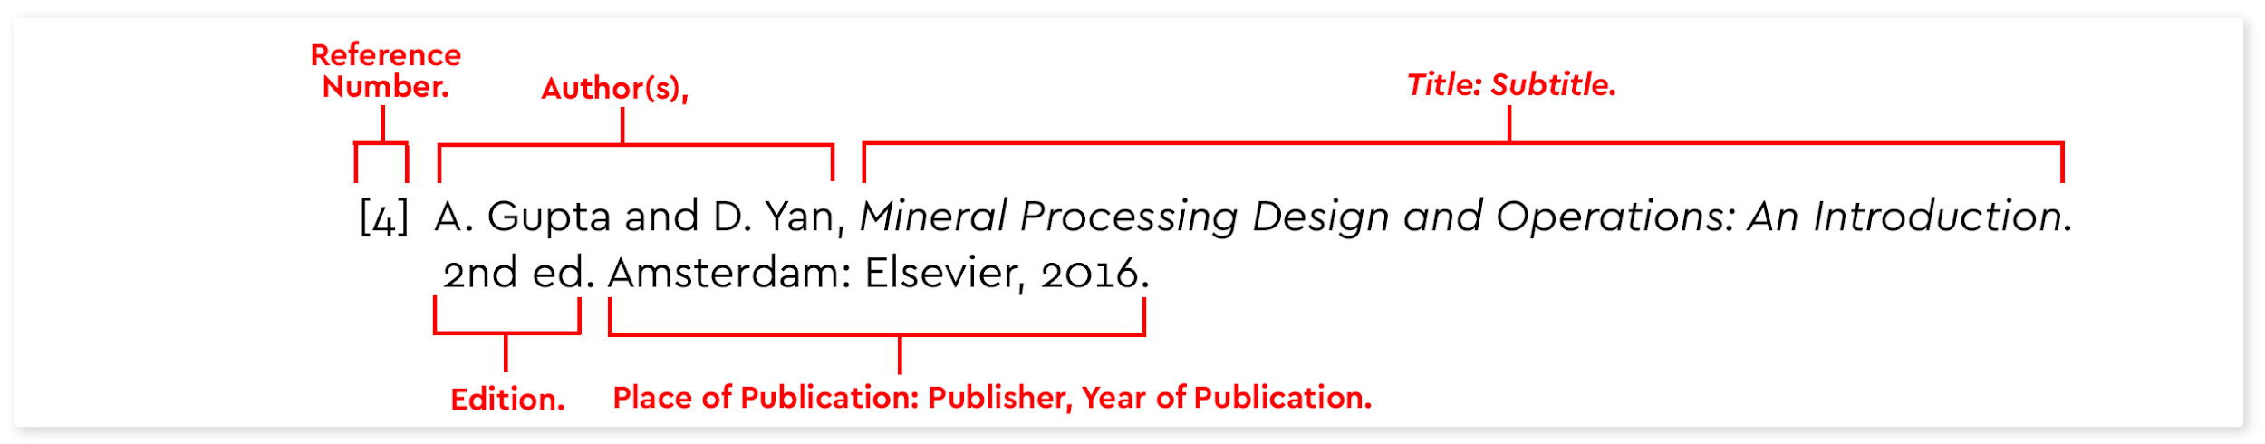
The Basics

Slide 7
What are you citing?
Article from an online journal?
Book chapter from an ebook?
Document from Brightspace?

Slide 8
How we cite (reference page)
Documents listed in ascending numerical order based on when they appear in the text
Each document assigned a specific number in [ ] brackets
Use hanging indents
List all authors (up to 5) by first initial and last name (K. Skipsey).

Slide 9
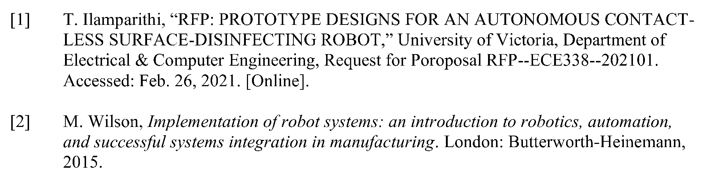

Slide 10
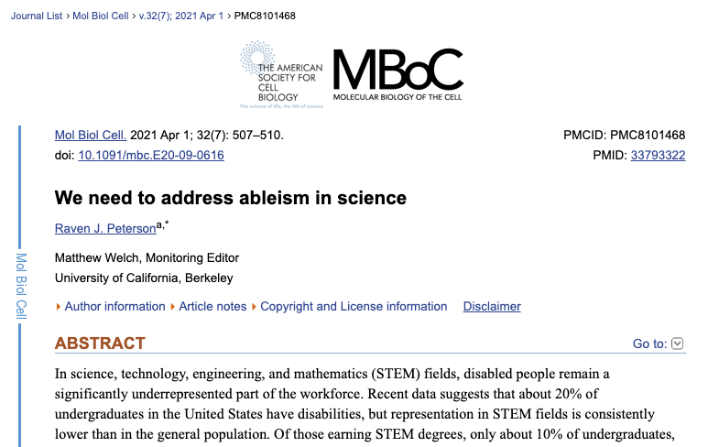
How to cite an article (online journal)
Journal Title
Year, Volume/Issue, pages
DOI
Article Title
Author

Slide 11
How to cite an article (online journal)
[1] R. Peterson, “We need to address ableism in science,” Mol Biol Cell., vol. 32, no. 7, pp. 507-510. Apr. 2021, doi: 10.1091/mbc.E20-09-0616

Slide 12

How to cite a book chapter (ebook)
Book title
Author
Pub Date
Publisher

Slide 13
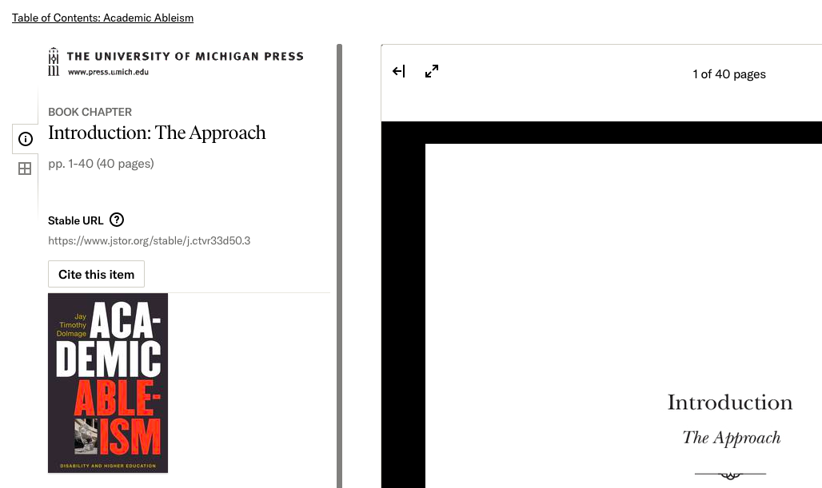
Chapter title
Pages
URL

Slide 14
How to cite a chapter (ebook)
[2] J. Dolmage, “Introduction: The Approach,” in Academic Ableism. Ann Arbor, MI, USA: University of Michigan Press, 2017, pp. 1-40. [Online]. Available: https://www.jstor.org/stable/j.ctvr33d50.3

Slide 15
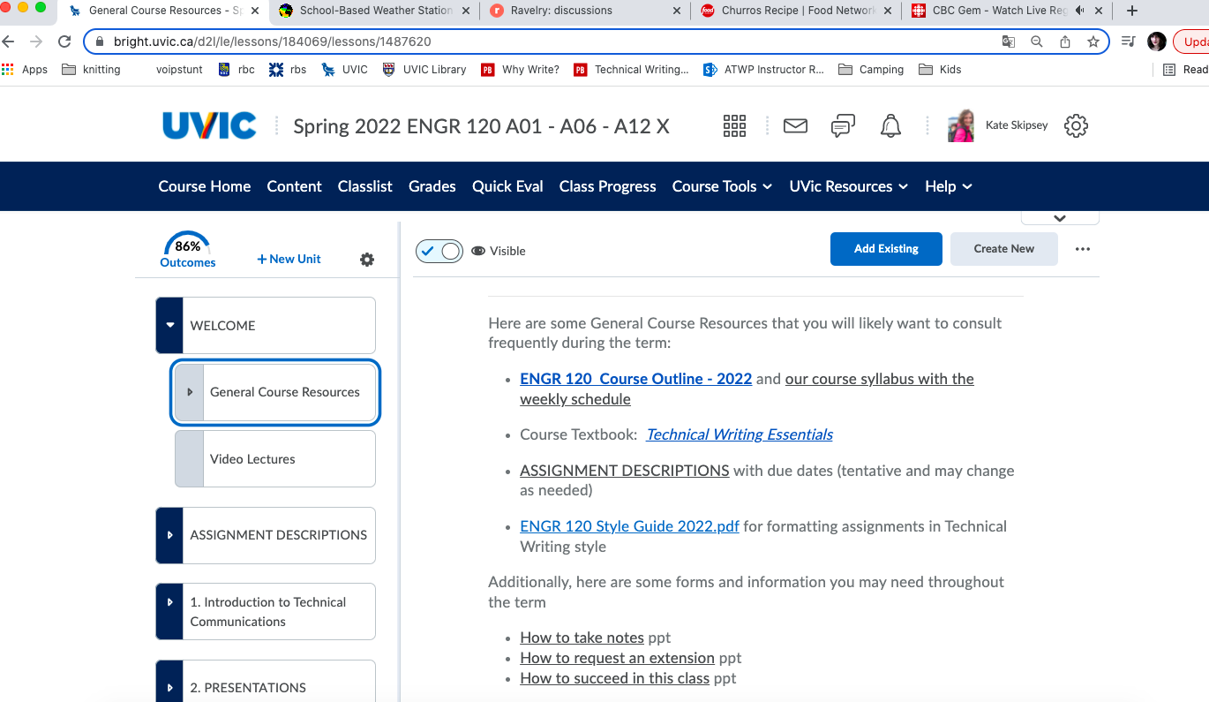
How to cite a document from Brightspace

Slide 16
How to cite a document from our Brightspace
[3] K. Skipsey. “ENGR 120 Design and Communication II Syllabus.” ENGR 120 (A01-A06-A12) Communications with Dr. Skipsey: General Course Resources. https://bright.uvic.ca/d2l/le/lessons/184069/lessons/1487620 (accessed March 4, 2022).

Slide 17
How we cite (in-text)
Use [ ] brackets with a number that corresponds to the document in the reference page
Cite immediately after author’s name or quotation (be consistent)
Cite at end of paraphrase if you haven’t used a signal phrase

Slide 18
How we cite (in-text)
Dolmage argues that “institutions (and their geographies) are powerfully rhetorical, and this rhetorical power shapes the bodies within these spaces” [2, p.7].
Dolmage [2] argues that universities occupy a rhetorical space that affects those who study and work there. He continues by exploring how these spaces exclude disabled students and faculty.
Paraphrase using signal phrase doesn’t need citation

Slide 19
IEEE Exercise
In small groups, revise one of the “IEEE Worksheet” citations. You’ll present the fixed citation to the class.
Steps:
Indicate what’s wrong with the citation
Fix it
Explain it to the class

Slide 20
Recap
Each kind of document has its own citation requirements
Citations should be organized in ascending order based on when they appear in the document
If in doubt, cite! Failure to cite is plagiarism

Slide 21
Further information
TWE Chapter 6
IEEE Reference Guide 2020

